Slide 1

7th Grade Math
Unit 4, Lesson 9 Finding the Area of a Circle Volume 1, pg. 167

Slide 2


Benchmark
MA.7.GR.1.4
Explore and apply a formula to find the area of a circle to solve mathematical and real-world problems.
volume 1, pg. 167

Slide 3
Integrated Mathematical Thinking and Reasoning Standards
MA.K12.MTR.1.1 Actively participate in effortful learning both individually and collectively.
MA.K12.MTR.2.1 Demonstrate understanding by representing problems in multiple ways.
MA.K12.MTR.4.1 Engage in discussions that reflect on the mathematical thinking of self and others.
MA.K12.MTR.7.1 Apply mathematics to real-world contexts.
volume 1, pg. 167

Slide 4

Learning Target
I can find the area of a circle given the radius or diameter.
volume 1, pg. 167

Slide 5

Warm-Up
volume 1, pg. 168

Slide 6
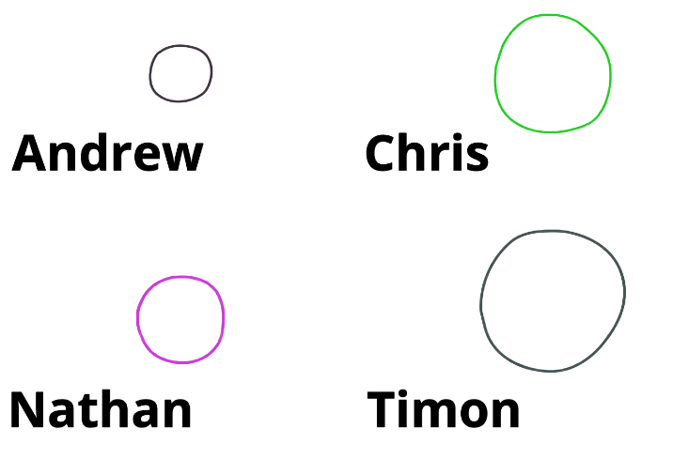
4.9.1 Warm-Up: Which Is the Best?
Rank each person’s image based on which looks most like a circle.
Explain how you decided upon your ranking.
volume 1, pg. 168
Notes:
Video Link: https://algebranation.wistia.com/medias/fi4fidi5y8

Slide 7

Guided Instruction
volume 1, pg. 168

Slide 8

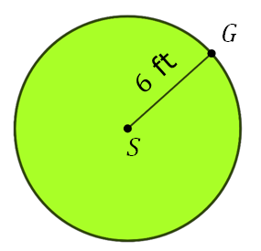
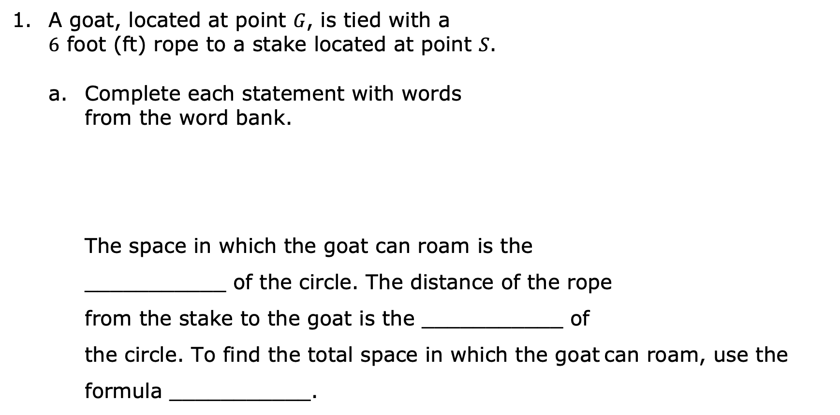
4.9.2 Guided Instruction: Finding the Area of a Circle
A goat, located at point 𝐺, is tied with a $6$ foot (ft) rope to a stake located at point 𝑆.
Complete each statement with words from the word bank.
The space in which the goat can roam is the
___________ of the circle. The distance of the rope
from the stake to the goat is the ___________ of
the circle. To find the total space in which the goat can roam, use the formula ___________.
$A= πr$² | radius | $$C= 2πr$$ | area | circumference
volume 1, pg. 168

Slide 9

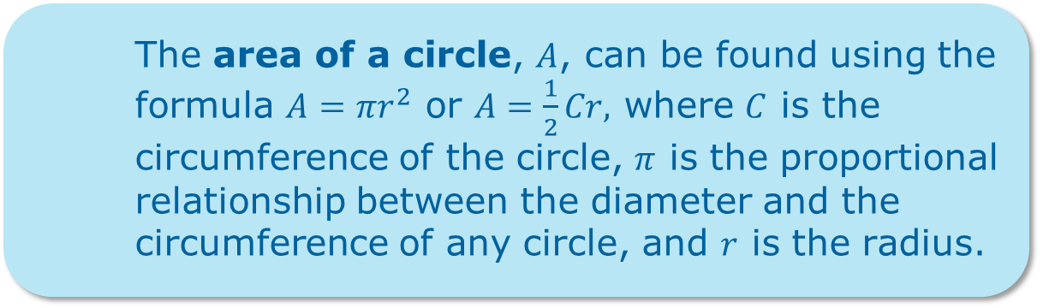
What is the area over which the goat can roam?
The area of a circle, $A$, can be found using the formula $A=πr^{2}$ or $A=\frac{1}{2}Cr,$ where $C$ is the circumference of the circle, $π$ is the proportional relationship between the diameter and the circumference of any circle, and $r$ is the radius.
volume 1, pg. 168

Slide 10
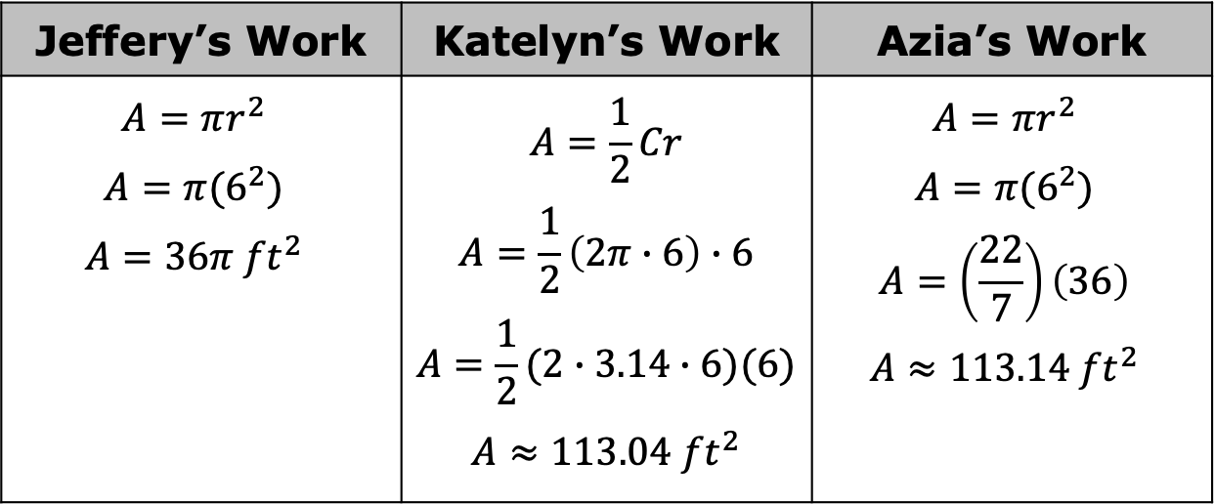

Jeffery, Katelyn, and Azia each found the area, in square feet ($ft2$), in which the goat can roam. Their work is shown.
Explain why Jeffery uses the equal sign ($=$) but Katelyn and Azia both use the approximate sign ($≈$).
Jeffery’s Work | Katelyn’s Work | Azia’s Work
$$A=πr^{2}$$ $$A=π(6^{2})$$ $$A=36π {ft}^{2}$$ | $$A=\frac{1}{2}Cr$$ $$A=\frac{1}{2}\left(2π∙6\right)∙6$$ $$A=\frac{1}{2}(2∙3.14∙6)(6)$$ $$A≈113.04 {ft}^{2}$$ | $$A=πr^{2}$$ $$A=π(6^{2})$$ $$A=\left(\frac{22}{7}\right)\left(36\right)$$ $$A≈113.14 {ft}^{2}$$
volume 1, pg. 169

Slide 11
Harold said that he used the 𝜋 button on his calculator instead of using an approximate value for 𝜋. What answer did Harold get, rounded to the hundredths place?
When finding the area of a circle, always write answers using the representation of 𝜋 based on the directions given in the problem.
volume 1, pg. 169

Slide 12

Guided Practice
volume 1, pg. 169

Slide 13

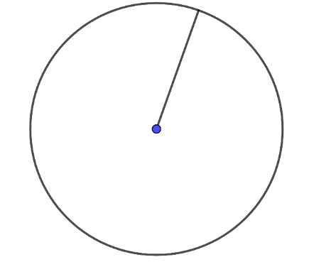
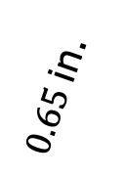
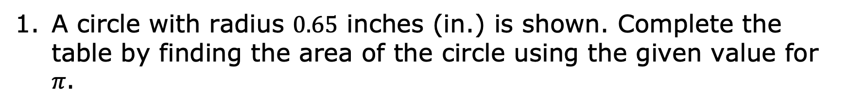
4.9.3 Guided Practice: Finding the Area of a Circle
A circle with radius $0.65$ inches (in.) is shown. Complete the table by finding the area of the circle using the given value for 𝜋.
$0.65$ in.
volume 1, pg. 169

Slide 14
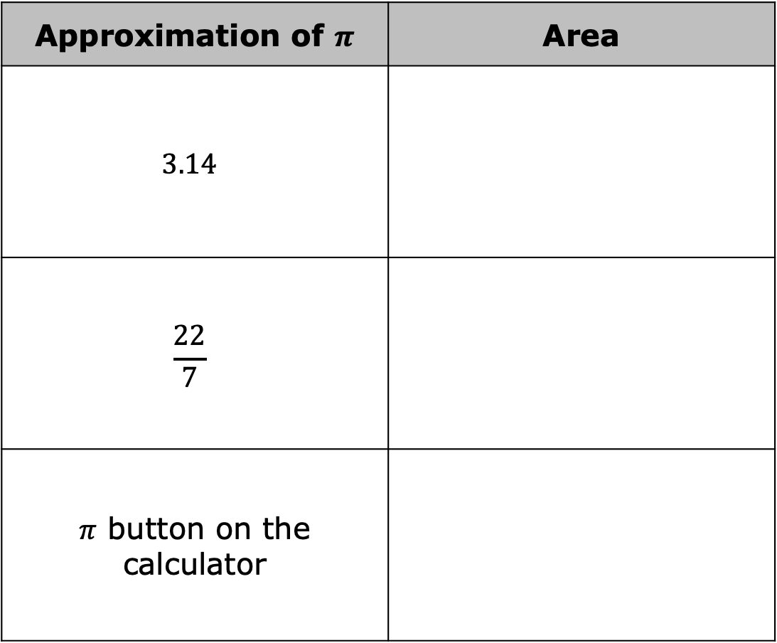
Approximation of $π$ | Area
$$3.14$$
$$\frac{22}{7}$$
$π$ button on the calculator
volume 1, pg. 169

Slide 15
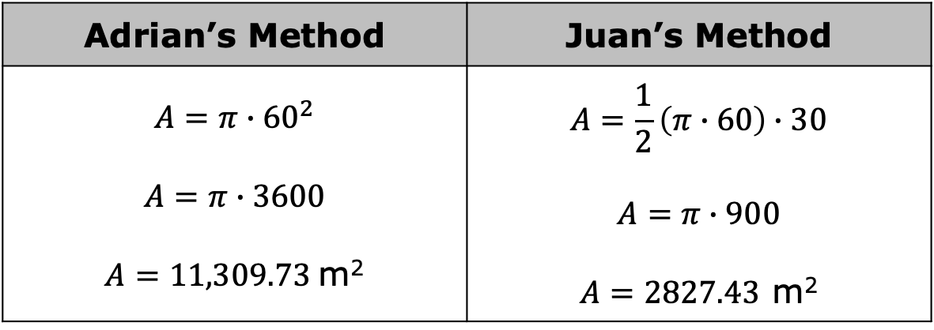
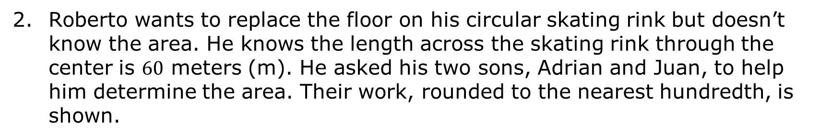
Roberto wants to replace the floor on his circular skating rink but doesn’t know the area. He knows the length across the skating rink through the center is $60$ meters (m). He asked his two sons, Adrian and Juan, to help him determine the area. Their work, rounded to the nearest hundredth, is shown.
Adrian’s Method | Juan’s Method
$$A=π∙{60}^{2}$$ $$A=π∙3600$$ $A=11,309.73$m² | $$A=\frac{1}{2}\left(π∙60\right)∙30$$ $$A=π∙900$$ $A=2827.43$ m²
volume 1, pg. 170

Slide 16
Whose method is correct?
Explain the mistake that was made to the son who made the error.
volume 1, pg. 170

Slide 17

Your Turn
volume 1, pg. 170

Slide 18
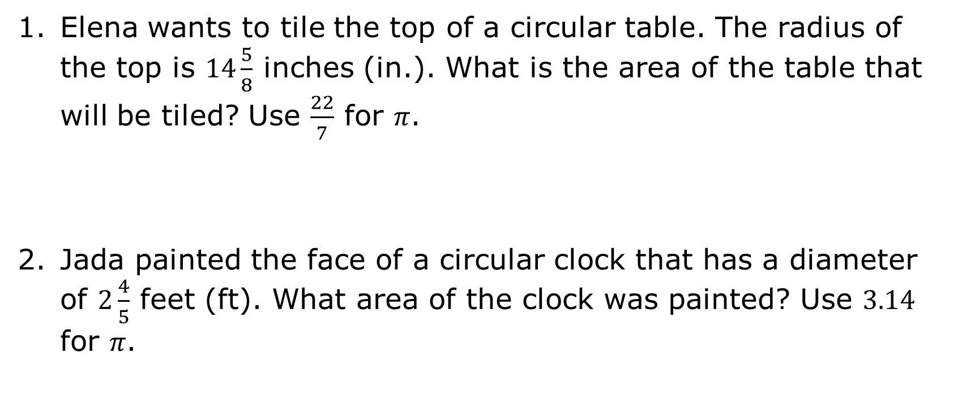
4.9.4 Your Turn!
Elena wants to tile the top of a circular table. The radius of the top is $14\frac{5}{8}$ inches (in.). What is the area of the table that will be tiled? Use $\frac{22}{7}$ for 𝜋.
Jada painted the face of a circular clock that has a diameter of $2\frac{4}{5}$ feet (ft). What area of the clock was painted? Use $3.14$ for 𝜋.
volume 1, pg. 170

Slide 19
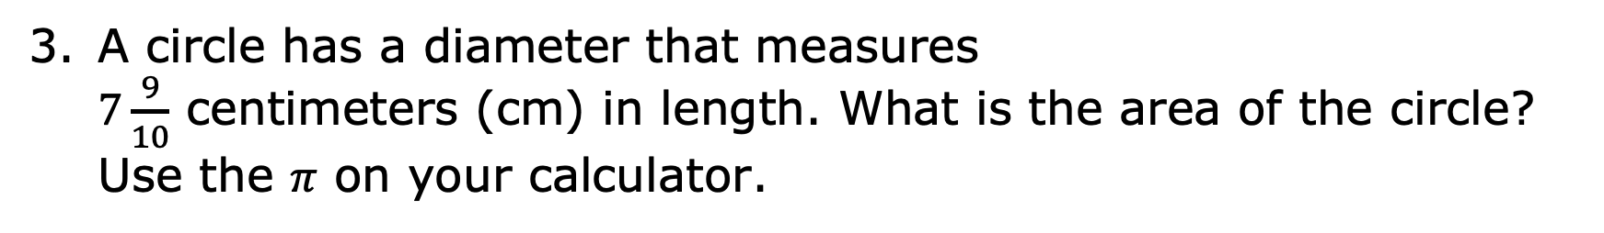
A circle has a diameter that measures $7\frac{9}{10}$ centimeters (cm) in length. What is the area of the circle? Use the 𝜋 on your calculator.
volume 1, pg. 170

Slide 20

Wrap-Up
volume 1, pg. 171

Slide 21
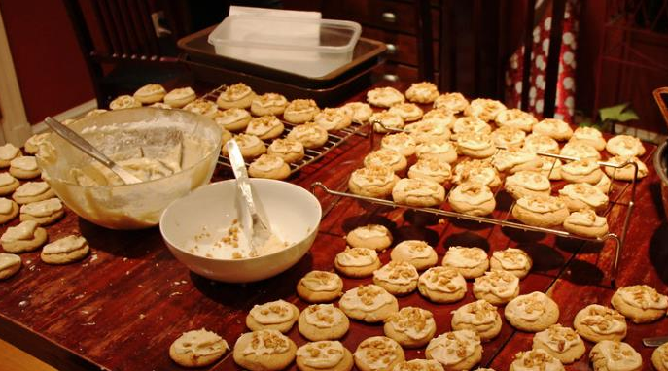
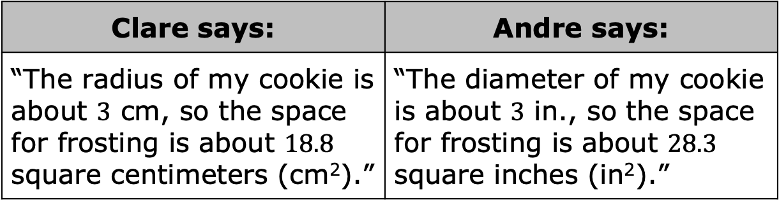
4.9.5 Wrap-Up: Error Analysis
Clare and Andre are baking and frosting cookies.
Clare says: | Andre says:
“The radius of my cookie is about $3$ cm, so the space for frosting is about $18.8$ square centimeters (cm²).” | “The diameter of my cookie is about $3$ in., so the space for frosting is about $28.3$ square inches (in²).”
volume 1, pg. 171

Slide 22
Who, if anyone, correctly approximated how much space there is to spread frosting on their cookie?
Write to either Clare or Andre an explanation of why their statement is incorrect.
volume 1, pg. 171

